Slide 1

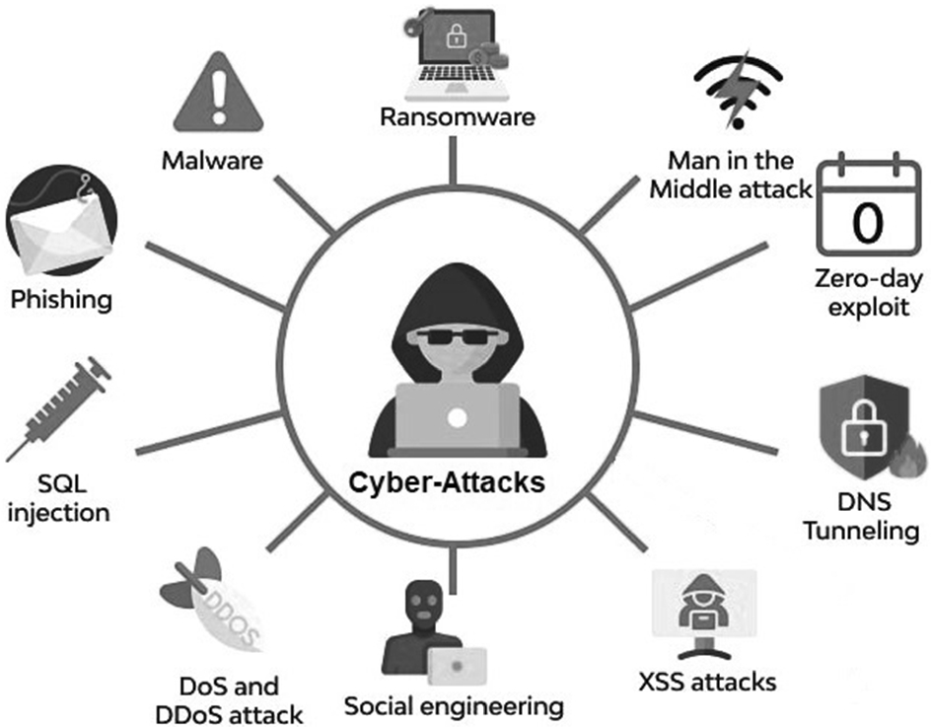
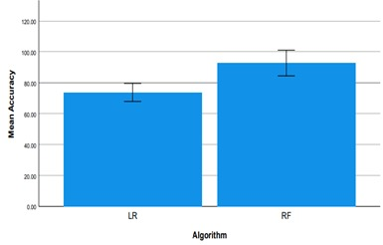

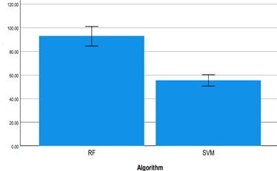
Register No: 192425132
Student Name: G.Akshya
Guided By Dr. K . Koppiahraj
A Comparative Study of modern AI methods and techniques for cyber crime prediction and detection
The exponential growth of digital technologies has significantly transformed the modern world, enabling seamless connectivity and access to information.
However, this digital revolution has also led to a sharp rise in cybercrime.
Cybercrimes such as identity theft, phishing, ransomware attacks, and unauthorized access to sensitive data demand sophisticated and proactive security mechanisms.
This study presents a comparative analysis of two widely used AI algorithms Logistic Regression (LR) and Random Forest (RF) in the context of cybercrime prediction and detection.
INTRODUCTION
MATERIALS AND METHODS
This study employed a data-driven approach to evaluate and compare the performance of Logistic Regression (LR) and Random Forest (RF) algorithms for cybercrime prediction and detection.
A publicly available cybersecurity dataset was selected as the primary source of data. The dataset contained thousands of labeled records representing both normal and malicious network activity. Each record comprised various network traffic features such as IP addresses, protocol types, duration, packet counts, and connection flags.
The data was cleaned and preprocessed by handling missing values, encoding categorical variables, and normalizing input feature to ensure consistency for both logistic regression and random forest.
Both LR and RF were trained and tested using techniques like cross validation or train test split. This mean accuracy for each model was calculated and visualized with erroe bars to show performance variation across runs.
The bar chart illustrates the mean accuracy of two classification algorithms Logistic Regression (LR) and Random Forest (RF) — in predicting outcomes, likely in the context of cybercrime detection.
The Logistic Regression (LR) algorithm achieved a mean accuracy of approximately 75%, with a small error margin (as shown by the error bar).
Random Forest (RF) performs better than Logistic Regression (LR) in terms of mean accuracy, based on the visual comparison.
RF is also slightly more variable, as seen from the longer error bar.
In contrast, the Random Forest (RF) algorithm significantly outperformed LR, achieving a mean accuracy close to 95%, with a slightly higher variability indicated by the error bar.
LR has a lower mean accuracy and a smaller error bar compared to RF.
Fig 1: LR vs RF
RESULTS
Fig 1: LR vs RF
The findings from this comparative study highlight the potential and effectiveness of AI-based techniques in cybercrime prediction and detection.
By analyzing the performance of two prominent machine learning algorithms—Logistic Regression (LR) and Random Forest (RF)—on a cybercrime dataset.
It became evident that the choice of algorithm significantly impacts prediction accuracy, sensitivity, and overall robustness of a detection system.
Logistic Regression, as a linear model, demonstrated reasonable performance in identifying cybercrime patterns. It performed well in cases where the relationship between input features and the target class was approximately linear.
The Random forest demonstrate a highest mean accuracy than logistic regression indicating that random forest is more effective in handling the dataset used for this study highlites the random forest and LR.
Although both algorithms show the variability in some cases making more effective in predicting the cyber crimes.
DISCUSSION AND CONCLUSION
BIBLIOGRAPHY
Cao, D.M., Sayed, M.A., Islam, M.T., Mia, M.T., Ayon, E.H., Ghosh, B.P., Ray, R.K. and Raihan, A., 2024. Advanced cybercrime detection: A comprehensive study on supervised and unsupervised machine learning approaches using real-world datasets. Journal of Computer Science and Technology Studies, 6(1), pp.40-48.
Faghiri, A.K., 2022. The Use Of Artificial Intelligence In The Criminal Justice System (A Comparative Study). Webology, 19(5).
Inuwa, M.M. and Das, R., 2024. A comparative analysis of various machine learning methods for anomaly detection in cyber attacks on IoT networks. Internet of Things, 26, p.101162.
Khan, M.A.Z., Al-Kar aki, J. and Mahafzah, E., 2024. Cybercrime Prediction via Geographically Weighted Learning. arXiv preprint arXiv:2411.04635.
Shafik, W., 2024. Predicting future cybercrime trends in the metaverse era. In Forecasting cyber crimes in the age of the metaverse (pp. 78-113). IGI Global Scientific Publishing.
A Comparative Study of Traditional methods and AI models for cyber crime prediction.
INTRODUCTION
Artificial Intelligence (AI) and Machine Learning (ML) techniques have emerged as powerful tools in the fight against cybercrime.
By learning from historical data and recognizing hidden patterns, these models can detect malicious activity in real time, even in complex and noisy environment.
AI models can automate threat detection and response, learn from new data, and adapt to evolving cyber threats, making them potentially more effective than traditional methods.
In contrast, Random Forest, a robust ensemble learning method, offers high accuracy and resilience to overfitting, especially when dealing with large, high-dimensional cybersecurity datasets.
MATERIALS AND METHODS
The methodology for cybercrime prediction and detection using LF and Random Forest (RF) involves a structured approach starting with the identification and definition of the cybercrime problem, such as intrusion detection or phishing detection.
This is followed by the collection of relevant datasets like KDD Cup 99, which contain labeled examples of normal and malicious activities.
The data is preprocessed through techniques normalization, handling missing values, and feature selection to improve model performance.
These models are then trained and evaluated using performance metrics like accuracy, precision, recall, and F1-score to assess their effectiveness in detecting and predicting cybercrimes. This methods and methodologies helps us to reduce the malicious activities in the real time applications.
The accuracy between the both two algorithms were done by comparing the Random forest and LF we can plot the graph between those two algorithms.
These are the methods and methodologys we have to follow for the project.
RESULTS
The graph presents the mean accuracy of two machine learning algorithms — Random Forest (RF) and (SVM) in handling the classification task, possibly related to cybercrime detection.
Random Forest (RF) achieved a mean accuracy of approximately 90–95%, indicating strong performance with moderate variability.
Support Vector Machine (SVM) performed significantly lower, with a mean accuracy of around 65–70%, and a relatively small error margin.
The comparison clearly highlights that Random Forest outperforms SVM in terms of classification accuracy. Given accuracy and ability to handle complex patterns, RF proves to be a more robust and reliable algorithm for this task.
Thus in both the cases Random forest plays a very crucial role in predicting and detecting the cyber crimes
When this technology combine with modern approaches there will be more better output in detecting cyber crimes.
Fig 2: RF VS SVM
DISCUSSION AND CONCLUSION
The application of LF and Random Forest (RF) for cybercrime prediction and detection demonstrates the potential of machine learning in enhancing cybersecurity.
LF being a simple yet effective algorithm, performs well when the data is well-distributed and noise-free, but its performance can degrade with large datasets due to high computational cost.
On the other hand, Random Forest offers better scalability and accuracy, as it combines the strengths of multiple decision trees and handles large datasets with higher dimensionality efficiently. This comparition highlites the Accuracy in detecting and preventing the cyber crimes.
Random Forest (RF) achieved a higher mean accuracy compared to Logistic Regression (LR), indicating its superior performance in handling the given dataset.
The error bar for RF is slightly wider, suggesting more variability in its performance, while LR shows more consistent but lower accuracy.
This comparition highlites the RF and LF Accuracy in detecting and preventing the cyber crimes.
Rishad, S.S.I., Shakil, F., Tisha, S.A., Afrin, S., Hassan, M.M., Choudhury, M.Z.M.E. and Rahman, N., 2025. LEVERAGING AI AND MACHINE LEARNING FOR PREDICTING, DETECTING, AND MITIGATING CYBERSECURITY THREATS: A COMPARATIVE STUDY OF ADVANCED MODELS. American Research Index Library, pp.6-25.
Obioha Val, O., Olaniyi, O.O., Gbadebo, M.O., Balogun, A.Y. and Olisa, A.O., 2025. Cyber Espionage in the Age of Artificial Intelligence: A Comparative Study of State-Sponsored Campaign. Oluwaseun Oladeji and Gbadebo, Michael Olayinka and Balogun, Adebayo Yusuf and Olisa, Anthony Obulor, Cyber Espionage in the Age of Artificial Intelligence: A Comparative Study of State-Sponsored Campaign(January 22, 2025).
Chen, J., Bian, H. and Liang, H., 2025. A Network Security Situation Prediction Model Enhanced by Multi Head Attention Mechanism. Informatica, 49(18).
Khansadurai, A.M., Veluchamy, A.D., Balasubramani, S. and Balasubramaniyan, K., 2024. Crime Rate Prediction using Cyber Security and Artificial Intelligent.
BIBLIOGRAPHY

